Slide 1
Class 7: Practice Question please prepare and come to class for brainstorming
SE Team – Catalyst Task Force

Slide 2
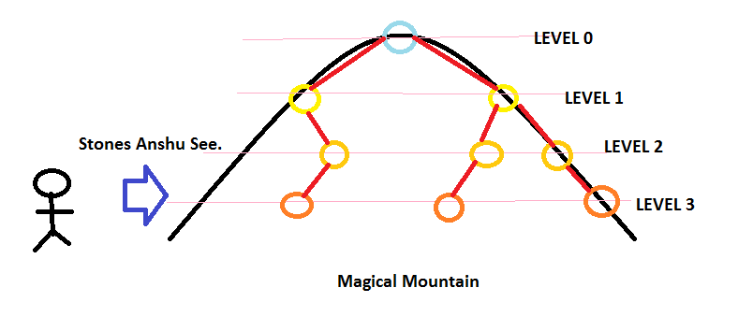
Practice: Advance Test –Magical Mountain
In 17th century our Chef was a Wizard. He asked his small son "Anshu" to bring him the secret of the Magical Mountain. The boy after travelling a lot reached the Mountain. The description of the Mountain was as follows:
Mountain contains N magical stones. Each of them has a unique number.
Mountain was divided into many levels, where at ith level atmost 2^i stones can be found.
Between stones there exist a magical path containing lava.
A stone can be connected with maximum of three stones.
Peak of the mountain contains stone with number 1.
If Stone 1 is first connected to stone 2 and then to 3. Assume 2 is to the left of 3.
Now, to get the secret of the mountain, Anshu started climbing from the left. On the way he used his magical wand to protect him from lava. But, while climbing he came to know that he is able to see only the one stone at each level. After reaching the peak he slided down and did the the same process. These stones that he saw shows the secret of the mountain, if they are placed in a non decreasing order on a sunny day. Anshu doesn't remember the stones number that he saw. Help him in recollecting them and getting the secret to his father.
The mountain looks like this:

Slide 3
Practice: Advance Test –Magical Mountain
Input
First line contains T the number of test cases.
First line of each test test case contains N.
Next N-1 lines contains X and Y the stones which are connected.
Output
Output the required non decreasing sequence.
Constraints and Subtasks
1 <= T <= 10
1 <= X, Y <= N
3<=N<=100000
Example
Input:
1
6
1 2
1 3
2 4
2 5
3 6
1
2
3
4
5
6

Slide 4
Practice: Advance Test –Mike and Stamps
Mike is fond of collecting stamps. He has a lot of rare and unusual ones in his collection. Unfortunately, a few days ago he was fired from his well-paid job.
But he doesn't complain about that, he acts! That's why Mike picked up N stamps from his collection and is going to sell them. He has already placed an announcement on the Internet and got M offers. Each offer can be described as a set of stamps, that the buyer wants to buy. Now Mike needs your help to choose a set of offers, that he should accept.
He can't accept offers partially. Also, as far as Mike has the only copy of each stamp, he can sell one stamp to at most one buyer.
Of course, Mike wants to maximize the number of accepted offers. Help him!
Input
The first line contains two integer N and M, denoting the number of the stamps and the number of the offers.
The next M lines contain the descriptions of the offers. The (i+1)'th line of the input contains the description of the i'th offer and corresponds to the following pattern: K_{i} A_{i, 1} A_{i, 2}, ..., A_{i, Ki}. K_{i} - is the number of the stamps, which the i'th buyer wants to buy, A_{i} - is the list of the stamps sorted in the ascending order.
Output
Output should contain the only integer, denoting the maximal number of the offers, that Mike can accept.
Constraints
1 ≤ N ≤ 20,000
1 ≤ M ≤ 20
Example Input: Output: 2
4 3
2 1 2
2 2 3
2 3 4
Practice

